Slide 1


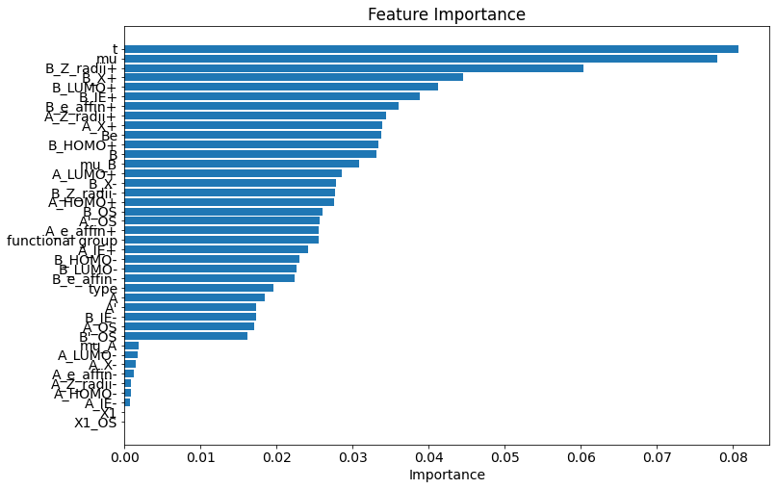
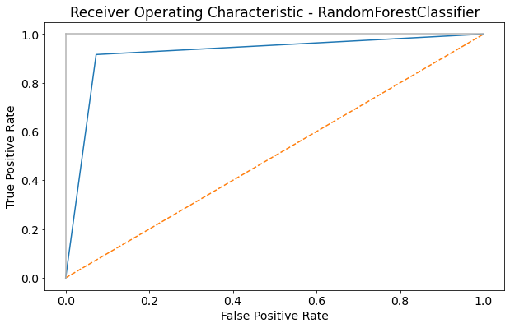
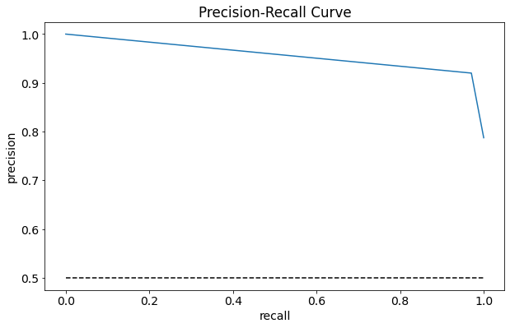
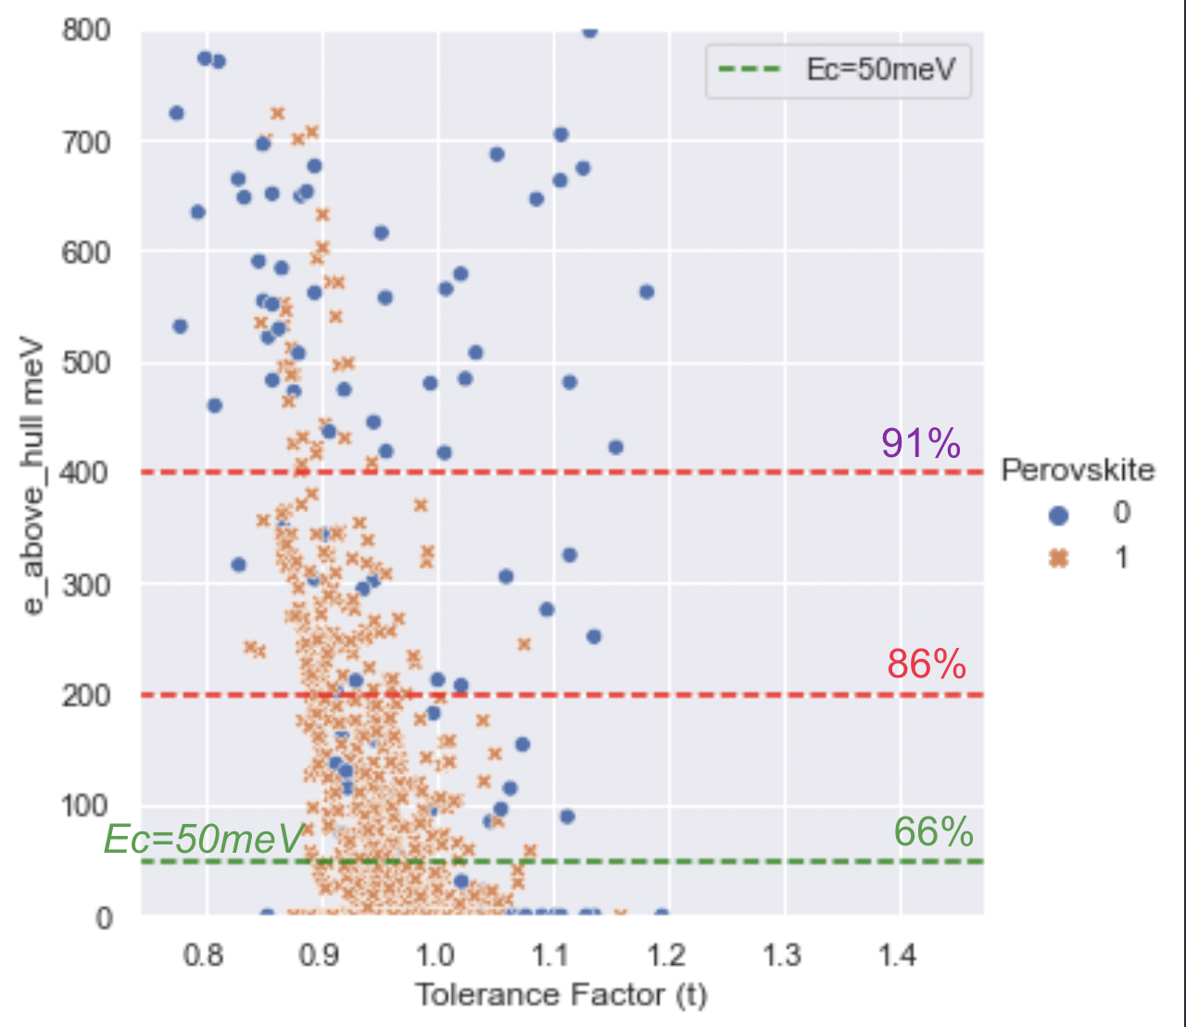
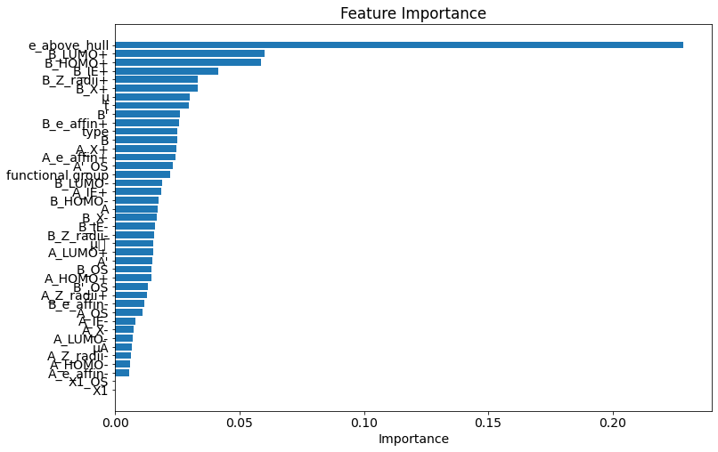
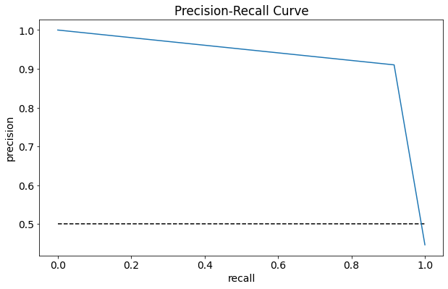
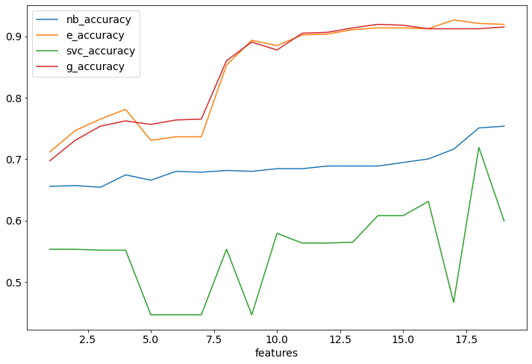
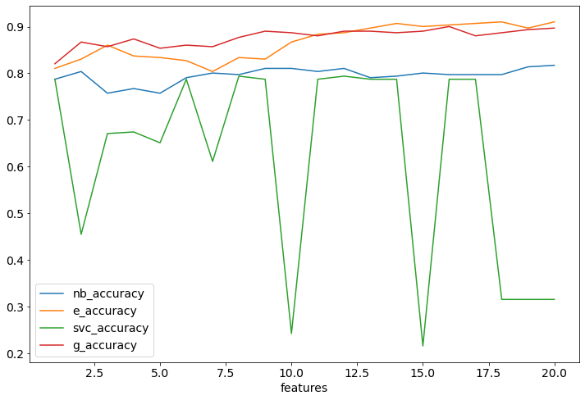
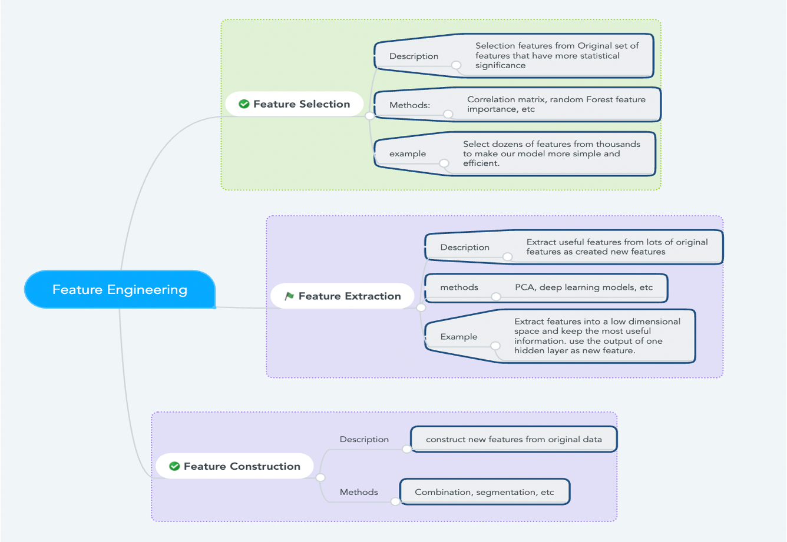
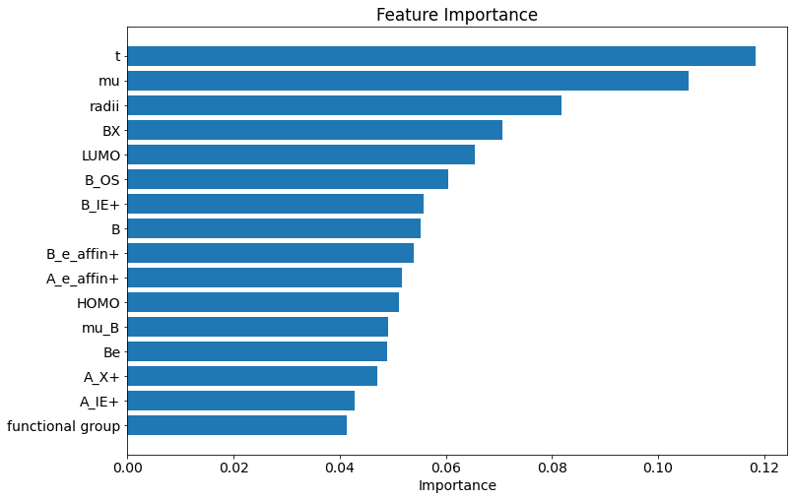
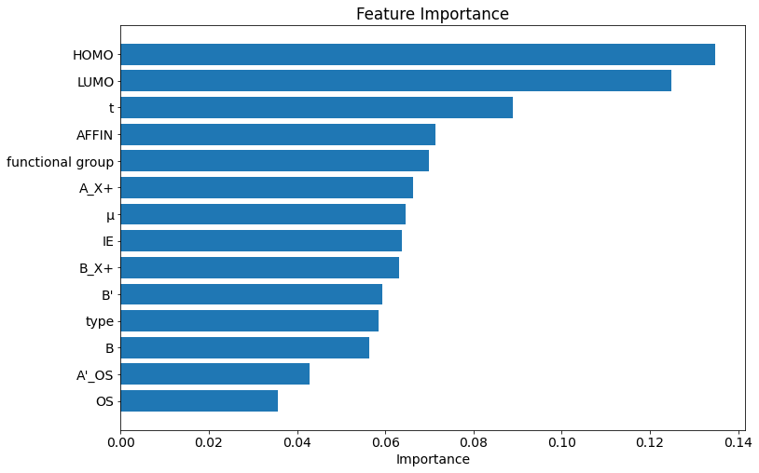
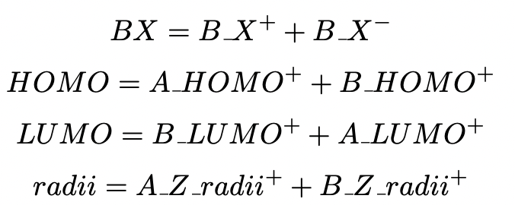
Belhaouari
To:
Masrat Rasool
Wed 9/7/2022 3:39 PM
A Machine Learning Approach for the Prediction of Formability and Thermodynamic Stability
of Single and Double Perovskite Oxides
Masrat Rasoolª, Samir Brahim Belhaouariª, Fedwa El Mellouhi^{b}
ªCollege of Science and Engineering, Hamad bin Khalifa University
^{b}Qatar Environment & Energy Research Institute, Hamad bin Khalifa University
Abstract
Results
Comparison of Perovskite Formability and Cubic Stability
Perovskite oxides' fascinating and versatile properties continue to pique widespread interest. These properties may be even more amenable to tuning if their compositional complexity is increased by using double perovskite-ordered configurations with multiple cations.The goal of this work is to optimally explore the vast chemical space of single and double oxide perovskites in search of new compositions that are likely to form stable compounds. We built ML models to predict the thermodynamic phase stability of perovskite oxides using data from the experimental literature and in-house density functional theory computations; these datasets, with 1505 and 3469 examples, respectively, represent the current state-of-the-art in the open literature on perovskite and double perovskite compounds[1] . Energy above the convex hull (E_{hull}) was used as a direct measure of phase stability through convex hull analysis. The Ehull value of each perovskite compound was correlated with a total of 70 features based on elemental property data, but feature selection revealed that only 16 features were necessary to generate the most accurate models without significant overfitting.
The 20 features and the related training data sets formability and Stability were used to create the two RFC models for formability and stability prediction stated above. Both models were also put to the test with random characteristics in order to determine their resilience and determine the genuine relevance values for the features. These random traits ranked near the bottom of the relative feature relevance rankings, as expected. The models were then put to the test on the test data sets that were constructed with the 80/20 shuffle split indicated before. Figures 2 and Figure 3 illustrate the formability and cubic stability classification models’ comprehensive feature importance and performance metrics, respectively.
It is unknown whether a formable perovskite is necessarily thermodynamically stable and vice versa. It necessary to have both formability and thermodynamic stability to ensure a composition’s viability as a perovskite candidate, or is one a more robust metric than the other? The intersection of the compounds in the formability and stability data sets was extracted to form a new data set D_{F ⋂ S} , which includes chemistries that are both experimentally known to form a perovskite or not and have energies above hull from DFT. Non-perovskites account for approximately 10% of these, with the remainder (1067) being perovskites.
Methods
Figure 2: Random forest classification results for perovskite formability. (a) Feature importance plot for all the features with non-zero values, (b) receiver operating characteristic (ROC) curves, and (c) precision-recall curves of the cross-validated random forest classification on test data
For predicting formability and thermodynamic stability of perovskites, our machine learning models went through five stages of development and validation.
(i) The development of a feature set capable of capturing the thermodynamic properties of perovskite oxides.
(ii) Using feature selection to identify significant features that have a high correlation with stability.
(iii) From the set of possible machine learning algorithms, choose the best machine learning model.
(iv) Validation of the model for various perovskite composition spaces, depending on the frequency with which each element appears in the training dataset. Each of the above processes required to build our machine learning models is described in detail in the sections that follow.
For all machine learning models, feature selection methods, and model evaluations, we used the python library scikit-learn [2], which is a free machine learning library.
Figure 3:Random forest classification results for cubic stability. (a) Feature importance plot for all the features with non-zero values, (b) receiver operating characteristic (ROC) curves, and (c) precision-recall curves of the cross-validated random forest classification on test data
We tested five classifiers, including: Gradient Boosting, support vector machines, Extra Trees, Naive Bayesian and Random Forest. The F1 score from cross-validation was used to optimize the parameters of the five models. Table 1 presents the accuracy, precision, recall, and F1 score of these five models.
Figure 6: Energy above hull (∆Eh) in meV is plotted against the tolerance factor (t) for the data set D_{F ∩S} which is the intersection of the perovskite formability and stability data sets (D_{F} and and D_{S})
Using an energy greater than the hull threshold of 50 meV/atom, 816 of the 1237 are classified as stable, while the remaining 421 are classified as unstable. It should be noted that we are only comparing chemistries here. We assume cubic symmetry for the DFT calculations; however, many of the known perovskites have been experimentally synthesized at lower non-cubic symmetries. Further, that we fixed a 50 meV/atom stability threshold for our stability data set to account for stability at lower symmetries. Close inspection reveals that, for an Ec threshold of 50 meV/atom, 56 percent of the compounds in the data set are perovskites and thermodynamically stable, while 10 percent are not perovskites and are not stable, implying that there is agreement between the formability and stability metrics for 66 percent of the data set.
Table 1: Comparison of Classification Accuracy, Precision, Recall and F1 Score among five classifiers with 20 features.
Model | Random Forest | Extra Trees | Radient Boosting | Support Vector | Naive Bayes
Accuracy | 0.897 | 0.910 | 0.897 | 0.90 | 0.90
Precision | 0.89 | 0.91 | 0.89 | 0.89 | 0.89
Recall | 0.89 | 0.91 | 0.89 | 0.89 | 0.89
F1 Score | 0.88 | 0.91 | 0.88 | 0.88 | 0.88
Conclusion
Figure 4: The classification accuracy of test dataset and the number of features for five classifier for formability and stability dataset.
To summarize, a systematic computational screening strategy for identifying novel single and double oxide perovskites is presented, which efficiently explores a large fraction of the double perovskite chemical space. To predict the formability and thermodynamic stability of single and double oxide perovskites, ML classification models based on random forests and Extra Trees were developed. The ML models were trained to be as accurate as possible while minimizing variance.
The thermodynamic cubic stability metric was discovered to be more conservative than perovskite formability, possibly due to the Ec = 50meV threshold. The ML approach employed in this produced similar results with less features.
Further, the classification accuracy of these five classifiers against the number of features is graphed for comparison purposes. The results obtained were graphed and is depicted in figure 4. As can be seen, extra trees classifier provides the highest accuracy with less than 20 features.
Generating New Features
Figure 1: Ontology of Feature Engineering in this work
The new features were produced by combining the features with similar chemical properties and almost same importance. Four new features BX,HOMO,LUMO and radii are generated by combining their A-site and B-site ions. The total number of features are reduced.
The benefits would be:
Reduces Overfitting: Because there is less redundant data, there is less opportunity to make decisions based on noise.
Improves Accuracy: Less misleading data means better modeling accuracy.
Reduces Training Time: With less data, algorithms can train faster.
Feature Generation and Selection
To train the categorization models, a vast number of structural and chemical features were first added. We used Recursive Feature Elimination (RFE) [3], a feature selection approach to remove redundant or irrelevant features. The number of times that the randomized approach picks a certain feature by repeating random subsamples of the data and fitting to a logistic regression model in a classification task (or lasso model for regression) [4] is used to select features in stability selection.
RFE picks the most important features by iteratively deleting those with the smallest weight supplied by an extra trees classifier in a classification task [2].
The quantity of mutual information between each feature and the target classification value is used to rank all features in univariate feature selection. Based on entropy measured by a nearest neighbor, mutual information assesses the degree of reliance between features and the goal value. Prior to performing feature selection, all features are standardized to have a mean of 0 and a standard deviation of 1. As standardization of the feature set is a frequent need for many machine learning models, such as artificial neural networks [6] and support vector machines [5], which are both sensitive to feature scaling, thus normalization is employed to ensure that all features are scaled in the same way.
Acknowledgement
The funding received for the Project, An Artificial Intelligence Platform for Accelerating Materials Discovery (AIPAM), awarded by the Hamad Bin Khalifa University Vice President Office grant number VPR-TG01-006
References
1. Anjana Talapatra et al. “A Machine Learning Approach for the Prediction of Formability and Thermodynamic Stability of Single and Double Perovskite Oxides”. In: Chemistry of Materials 33.3 (2021), pp. 845–858 2. Fabian Pedregosa et al. “Scikit-learn: Machine learning in Python”. In: the Journal of machine Learning research 12 (2011), pp. 2825–2830. 3. Isabelle Guyon et al. “Gene selection for cancer classification using support vector machines”. In: Machine learning 46.1 (2002), pp. 389–422. 4. David W Hosmer Jr, Stanley Lemeshow, and Rodney X Sturdivant. Applied logistic regression. Vol. 398. John Wiley & Sons, 2013. 5. Johan AK Suykens et al. Least squares support vector machines. World scientific, 2002. 6. Bayya Yegnanarayana. Artificial neural networks. PHI Learning Pvt. Ltd., 2009.
Figure 5 :Random forest classification results with newly generated features. Feature importance plot for all the features with non-zero values.
a) Fomability b) Thermodynamic Stability
The classical geometric tolerance factor (t) and octahedral factor (μ) are heavily featured on this list as well, which is typical. Furthermore, a variety of B-site symmetric properties such as the Zunger pseudopotential radius (Z radius), electronegativity (X), and LUMO are the most crucial in distinguishing between compounds that form perovskites and those that do not. Therefore, the importance of features is almost similar to the old feature set.

